Slide 1

9. Developing a secure signaling/control system based on XMPP and REST
RoboTractor: A Secure signaling and control system for remote management of Agricultural Vehicles using XMPP and REST.
Server
(XMPP Server)
(Apache Server)
Client
(XMPP Client)
Web Browser
(Admin Panel)

Slide 2
Attribute-Based Encryption (ABE)
blah

Slide 3
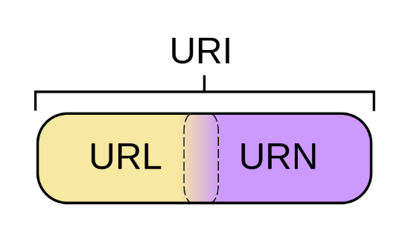
REST (Representational State Transfer) Architectural style used by the world wide web.
Uses HTTP methods GET, POST, PUT, DELETE to execute different actions
A REST(ful) API is a set of operations that can be invoked by means of any of the four verbs, using the URI as parameters for the operations.
Rest is faithful to the web domains
Ex: call a url with HTTP GET (http://someurl/product/1)
Here the URI or uniform resource identifier is broken up into the uniform resource locator (URL) and uniform resource name (URN)
URL: http://someurl/
URN: product/1

Slide 4

XMPP (eXtensible Messaging and Presence Protocol)
XML based communications protocol, open standard
How XMPP works
XMPP utilizes streams and stanzas
Stream: an open XML envelope sent before exchanging more XML elements (stanzas) between two entities (client or server).
The stream contains information such as destination address, protocol versions, and namespace declarations.
Stanza: specific, well-formed, complete XML element which either entity sends within an already open XML stream.
3 types of Stanzas: <presence/>, <message/>, and <iq/>

Slide 5
<message/> stanza
Used for sending Asynchronous, instantaneous message
Example message
<message to=“alice@gmail.com" from=“bob@gmail.com" type="chat" xml:lang="en"> <body>Hello?</body> </message>
This stanza is sent within the open stream Bob has to the XMPP server

Slide 6
<iq/> stanza
Info/Query
Can be one of four types: “get”, “set”, “result”, or “error”
Example of Alice requesting her roster (contact list)
<iq from=“alice@gmail.com" type="get" id="roster_1"> <query xmlns="jabber:iq:roster"/> </iq>
Response from server
<iq to=“alice@gmail.com" type="result" id="roster_1"> <query xmlns="jabber:iq:roster"> <item jid=“bob@gmail.com" name=“bob" subscription="both"> <group>Friends</group> </item> </query> </iq>

Slide 7
<presence/> stanza
Refers to the availability status of a contact
Four default types: “chat”, “dnd”, “away”, “xa”
Example of Bob going dnd
Bob’s client constructs a presence stanza
<presence xml:lang="en"> <show>dnd</show> <status>I am away</status> </presence>
The XMPP server broadcasts this presence to contacts in Bob’s Roster
<presence from=“bob@gmail.com" to=“alice@gmail.com" xml:lang="en"> <show>dnd</show> <status>I am away</status> </presence>

